Slide 1
CHAPTER 5:
IMPERFECTIONS IN SOLIDS
ISSUES TO ADDRESS...
• What are the solidification mechanisms?
• What types of defects arise in solids?
• Can the number and type of defects be varied
and controlled?
• How do defects affect material properties?
• Are defects undesirable?

Slide 2

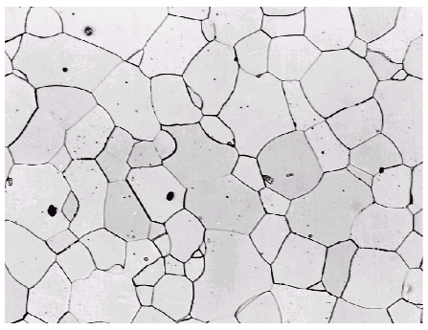
Imperfections in Solids
Solidification- result of casting of molten material
  2 steps
    Nuclei form
    Nuclei grow to form crystals – grain structure
Start with a molten material – all liquid
nuclei
crystals growing
grain structure
liquid
Adapted from Fig.5.19 (b), Callister’s MSE, Adapted Version.
Crystals grow until they meet each other

Slide 3
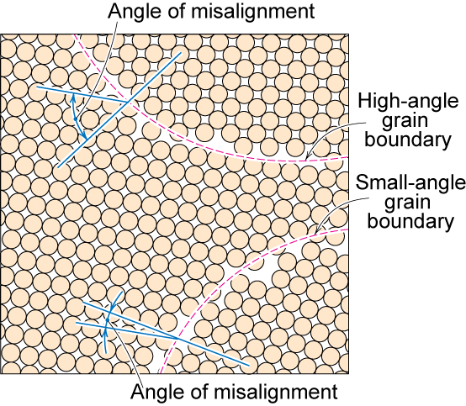
Polycrystalline Materials
Grain Boundaries
regions between crystals
transition from lattice of one region to that of the other
slightly disordered
low density in grain boundaries
  high mobility
  high diffusivity
  high chemical reactivity
From Fig. 5.11
Callister’s Materials Science and Engineering,
Adapted Version.

Slide 4
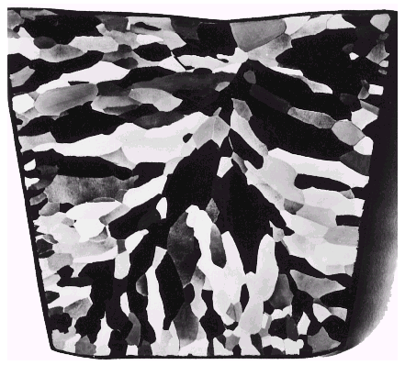
Solidification
Grains can be - equiaxed (roughly same size in all directions)
  - columnar (elongated grains)
~ 8 cm
heat
flow
Shell of equiaxed grains due to rapid cooling (greater ΔT) near wall
Columnar in area with less undercooling
Grain Refiner - added to make smaller, more uniform, equiaxed grains.
From Fig. 5.17
Callister’s Materials Science and Engineering,
Adapted Version.

Slide 5
Imperfections in Solids
There is no such thing as a perfect crystal.
What are these imperfections?
Why are they important?
Many of the important properties of materials are due to the presence of imperfections.

Slide 6
Types of Imperfections
• Vacancy atoms
• Interstitial atoms
• Substitutional atoms
Point defects
• Dislocations
Line defects
• Grain Boundaries
Area defects

Slide 7
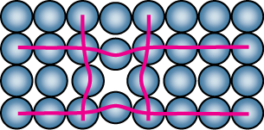
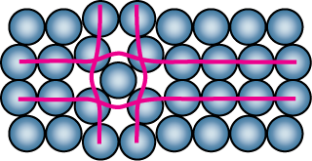
Point Defects
• Vacancies:
-vacant atomic sites in a structure.
Vacancy
distortion
of planes
• Self-Interstitials:
-"extra" atoms positioned between atomic sites.
self-
interstitial
distortion
of planes

Slide 8
Equilibrium Concentration:
Point Defects
• Equilibrium concentration varies with temperature!
No. of defects
Activation energy
⎛
−
⎞
N
v
⎜
Q
v
⎟
=
exp
⎜
⎟
No. of potential
⎝
⎠
N
k
T
defect sites.
Temperature
Boltzmann's constant
(1.38 x 10
-23
J/atom-K)
(8.62
x
10
-5
eV/atom-K)
Each lattice site
is a potential
vacancy site

Slide 9
Measuring Activation Energy
⎛
−
⎞
• We can get Q_{v} from
an experiment.
N
v
⎜
Q
v
⎟
=
exp
⎜
⎟
N
⎝
k
T
⎠
• Measure this...
• Replot it...
N
v
N
slope
v
ln
N
N
-
Q
v
/k
exponential
dependence!
T
1/
T
defect concentration

Slide 10
Estimating Vacancy Concentration
• Find the equil. # of vacancies in 1 m³ of Cu at 1000°C.
• Given:
ρ
= 8.4 g
/
cm
3
A
= 63.5 g/mol
Cu
Q
v
= 0.9 eV/atom
N
A
= 6.02 x 10²³
atoms/mol
0.9 eV/atom
⎛
−
⎞
N
v
⎜
Q
v
⎟
=
exp
⎜
⎟
= 2.7 x 10⁻⁴
N
⎝
k
T
⎠
1273K
8.62 x 10⁻⁵
eV/atom-K
N
A
For 1 m³
, N =
ρ
x
x
1 m³
= 8.0 x 10²⁸ sites
A
Cu
• Answer:
N
v
=
(2.7 x 10⁻⁴)(8.0 x 10²⁸) sites = 2.2 x 10²⁵ vacancies

Slide 11
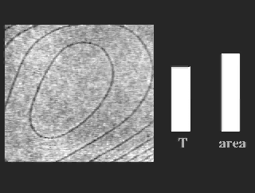
Observing Equilibrium Vacancy Conc.
• Low energy electron
microscope view of
a (110) surface of NiAl.
• Increasing T causes
surface island of
atoms to grow.
• Why? The equil. vacancy
conc. increases via atom
motion from the crystal
to the surface, where
they join the island.
Reprinted with permission from Nature (K.F. McCarty, J.A. Nobel, and N.C. Bartelt, "Vacancies in
Solids and the Stability of Surface Morphology",
Nature, Vol. 412, pp. 622-625 (2001). Image is
5.75 μm by 5.75 μm.) Copyright (2001) Macmillan Publishers, Ltd.
I
sland grows/shrinks to maintain
equil. vancancy conc. in the bulk.

Slide 12
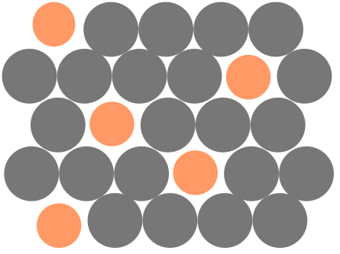
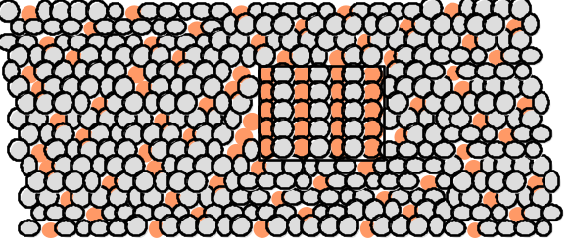
Point Defects in Alloys
Two outcomes if impurity (B) added to host (A):
• Solid solution of B in A (i.e., random dist. of point defects)
OR
Substitutional solid soln.
(e.g., Cu in Ni)
Interstitial solid soln.
(e.g., C in Fe)
• Solid solution of B in A plus particles of a new
phase (usually for a larger amount of B)
Second phase particle
--different composition
--often different structure.

Slide 13
Imperfections in Solids
Conditions for substitutional solid solution (S.S.)
W. Hume – Rothery rule
  1. Δr (atomic radius) < 15%
  2. Proximity in periodic table
    i.e., similar electronegativities
  3. Same crystal structure for pure metals
  4. Valency
    All else being equal, a metal will have a greater tendency to dissolve a metal of higher valency than one of lower valency

Slide 14
Imperfections in Solids
Application of Hume–Rothery rules – Solid Solutions
1. Would you predict
more Al or Ag
to dissolve in Zn?
2. More Zn or Al
in Cu?
Element Atomic Crystal Electro- Valence
Radius Structure nega-
(nm) tivity
Cu 0.1278 FCC 1.9 +2
C 0.071
H 0.046
O 0.060
Ag 0.1445 FCC 1.9 +1
Al 0.1431 FCC 1.5 +3
Co 0.1253 HCP 1.8 +2
Cr 0.1249 BCC 1.6 +3
Fe 0.1241 BCC 1.8 +2
Ni 0.1246 FCC 1.8 +2
Pd 0.1376 FCC 2.2 +2
Zn 0.1332 HCP 1.6 +2
Table on p. 141,
Callister’s Materials Science and Engineering,
Adapted Version.

Slide 15
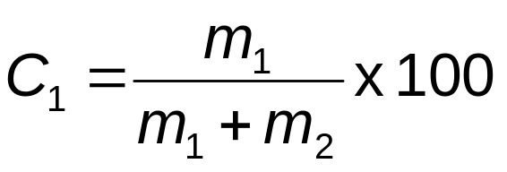
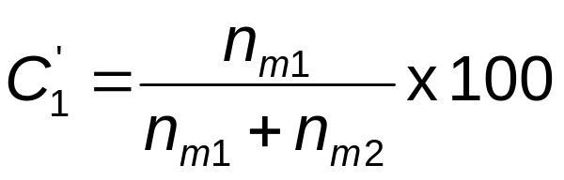
Imperfections in Solids
Specification of composition
  weight percent
m₁ = mass of component 1
atom percent
n_{m1} = number of moles of component 1

Slide 16
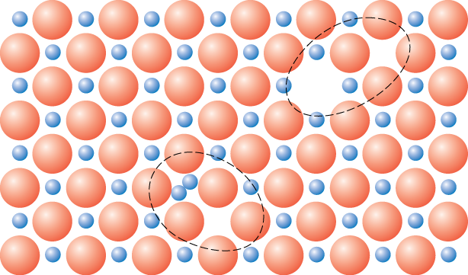
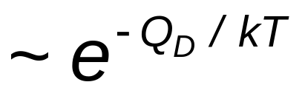
Defects in Ceramic Structures
• Frenkel Defect
--a cation is out of place.
• Shottky Defect
--a paired set of cation and anion vacancies.
Shottky
Defect:
From Fig. 5.4
Callister’s Materials Science and Engineering, Adapted Version.
(Fig. 5.4 is from W.G. Moffatt, G.W. Pearsall, and J. Wulff, The Structure and Properties of Materials, Vol. 1, Structure, John Wiley and Sons, Inc., p. 78.)
Frenkel
Defect
• Equilibrium concentration of defects

Slide 17
Impurities
• Impurities must also satisfy charge balance = Electroneutrality
• Ex: NaCl
Na
+
Cl
-
cation
• Substitutional cation impurity
vacancy
Ca
2+
Na
+
Na
+
Ca
2+
initial geometry
Ca
2+
impurity
resulting geometry
• Substitutional anion impurity
an
ion vacancy
O
2-
Cl
-
Cl
-
initial geometry
O
2-
impurity
resulting geometry

Slide 18
Line Defects
Dislocations:
• are line defects,
• slip between crystal planes result when dislocations move,
• produce permanent (plastic) deformation.
Schematic of Zinc (HCP):
• before deformation
• after tensile elongation
slip steps
From Fig. 10.8
Callister’s Materials Science and Engineering,
Adapted Version.

Slide 19
Imperfections in Solids
Linear Defects (Dislocations)
  Are one-dimensional defects around which atoms are misaligned
Edge dislocation:
  extra half-plane of atoms inserted in a crystal structure
  b ⊥ to dislocation line
Screw dislocation:
  spiral planar ramp resulting from shear deformation
  b || to dislocation line
Burger’s vector, b: measure of lattice distortion

Slide 20
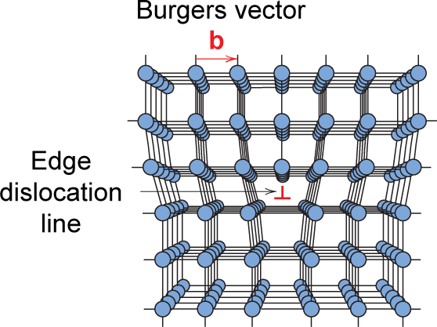
Imperfections in Solids
Edge Dislocation
Fig. 5.7
Callister’s Materials Science and Engineering,
Adapted Version.

Slide 21
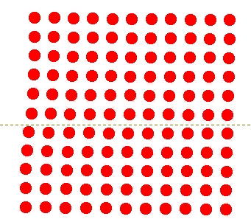
Motion of Edge Dislocation
• Dislocation motion requires the successive bumping
of a half plane of atoms (from left to right here).
• Bonds across the slipping planes are broken and
remade in succession.
Atomic view of edge
dislocation motion from
left to right as a crystal
is sheared.
(Courtesy P.M. Anderson)

Slide 22
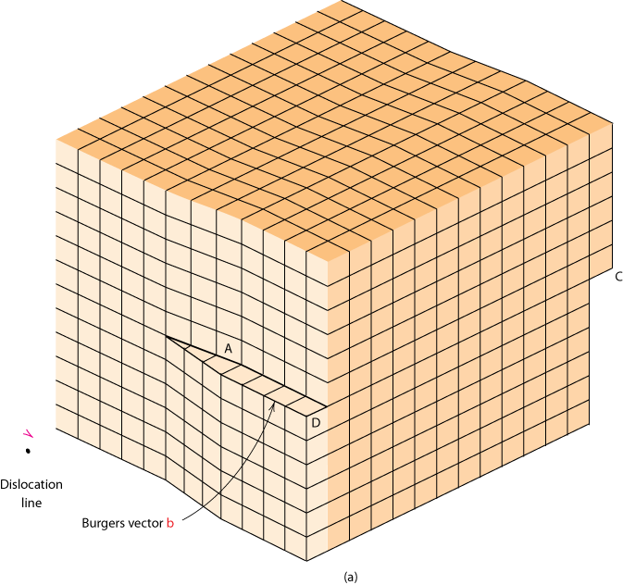
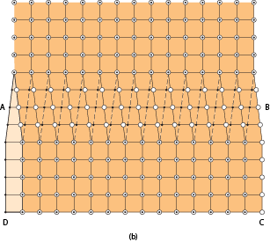
Imperfections in Solids
Screw Dislocation
Screw Dislocation
Dislocation
line
b
Burgers vector b
(b)
(a)
From Fig. 5.8
Callister’s Materials Science and Engineering,
Adapted Version.

Slide 23
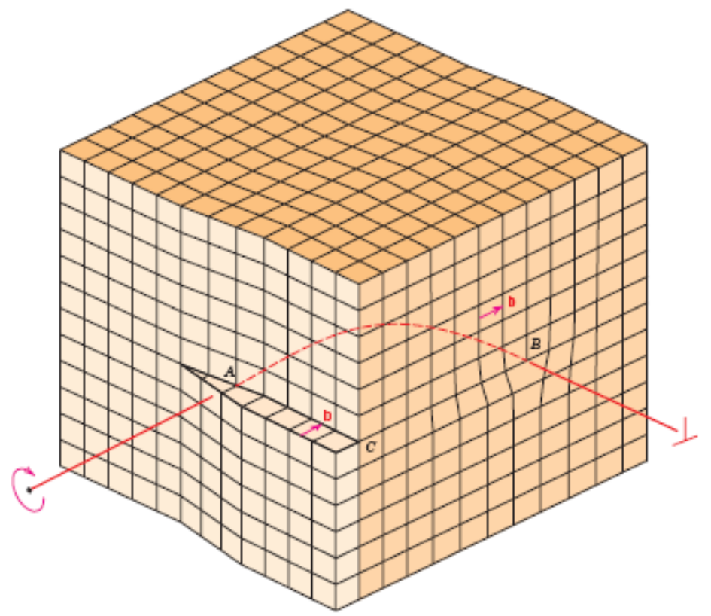
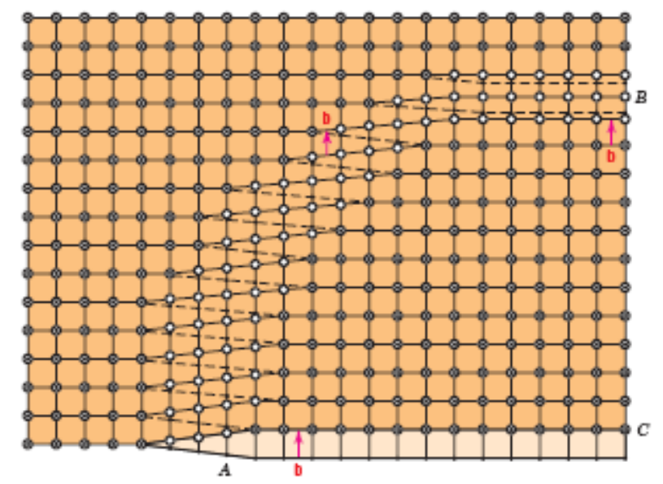
Edge, Screw, and Mixed Dislocations
Mixed
Edge
Screw
From Fig. 5.9
Callister’s Materials Science and Engineering,
Adapted Version.

Slide 24
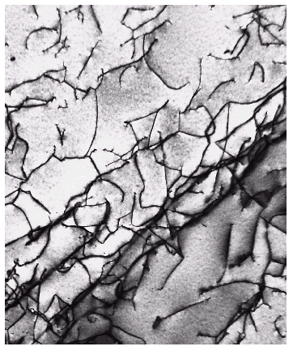
Imperfections in Solids
Dislocations are visible in electron micrographs
From Fig. 5.10
Callister’s Materials Science and Engineering,
Adapted Version.

Slide 25
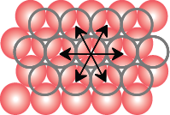
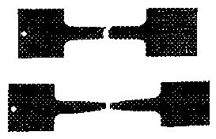
Dislocations & Crystal Structures
• Structure: close-packed
planes & directions
are preferred.
view onto two
close-packed
planes.
close-packed directions
close-packed plane (bottom)
close-packed plane (top)
• Comparison among crystal structures:
FCC: many close-packed planes/directions;
HCP: only one plane, 3 directions;
BCC: none
• Specimens that
were tensile
tested.
Mg (HCP)
tensile direction
Al (FCC)

Slide 26
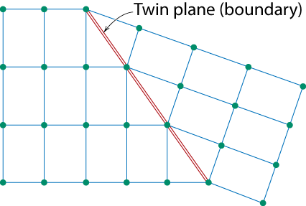
Planar Defects in Solids
One case is a twin boundary (plane)
  Essentially a reflection of atom positions across the twin plane.
Stacking faults
  For FCC metals an error in ABCABC packing sequence
  Ex: ABCABABC
From Fig. 5.13
Callister’s Materials Science and Engineering,
Adapted Version.

Slide 27
Microscopic Examination
Crystallites (grains) and grain boundaries. Vary considerably in size. Can be quite large
  ex: Large single crystal of quartz or diamond or Si
  ex: Aluminum light post or garbage can - see the individual grains
Crystallites (grains) can be quite small (mm or less) – necessary to observe with a microscope.

Slide 28
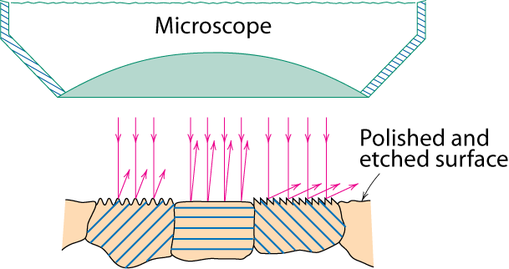
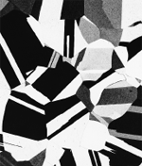
Optical Microscopy
• Useful up to 2000X magnification.
• Polishing removes surface features (e.g., scratches)
• Etching changes reflectance, depending on crystal
orientation.
From Fig. 5.18(b) and (c)
Callister’s Materials Science and Engineering,
Adapted Version.
(Fig. 5.18(c) is courtesy
of J.E. Burke, General Electric Co.
crystallographic planes
Micrograph of
brass (a Cu-Zn alloy)
0.75mm

Slide 29
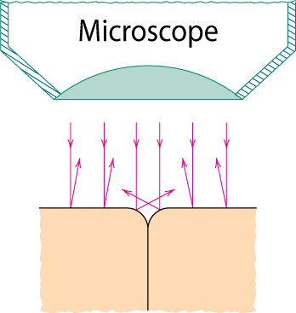
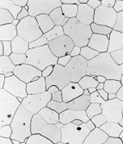
Optical Microscopy
Grain boundaries...
• are imperfections,
• are more susceptible
to etching,
• may be revealed as
dark lines,
• change in crystal
orientation across
boundary.
polished surface
surface groove
grain boundary
(a)
From Fig. 5.19(a) and (b)
Callister’s Materials Science and Engineering,
Adapted Version.
(Fig. 5.19(b) is courtesy
of L.C. Smith and C. Brady, the National Bureau of Standards, Washington, DC [now the National Institute of Standards and Technology, Gaithersburg, MD].)
ASTM grain
size number
N
= 2
n
-1
Fe-Cr alloy
number of grains/in²
at 100x
(b)
magnification

Slide 30
Optical Microscopy
Polarized light
  metallographic scopes often use polarized light to increase contrast
  Also used for transparent samples such as polymers

Slide 31
Microscopy
Optical resolution ca. 10⁻⁷ m = 0.1 μm = 100 nm
For higher resolution need higher frequency
  X-Rays? Difficult to focus.
  Electrons
    wavelengths ca. 3 pm (0.003 nm)
      (Magnification - 1,000,000X)
    Atomic resolution possible
    Electron beam focused by magnetic lenses.
Notes:
Optical microscopy good to ca. wavelength of light
Higher frequencies
X-rays – good idea but difficult to focus
Electrons - wavelength proportional to velocity with high voltage (high acceleration) get wavelengths ca. 3pm (0.003nm) (x1,000,000)

Slide 32

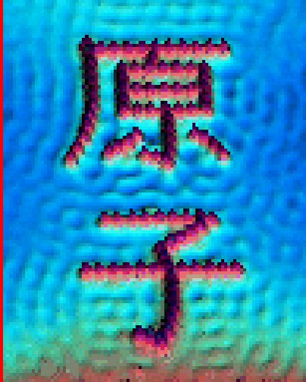
Scanning Tunneling Microscopy
(STM)
• Atoms can be arranged and imaged!
Photos produced from the work of C.P. Lutz, Zeppenfeld, and D.M. Eigler. Reprinted with permission from International Business Machines Corporation, copyright 1995.
Carbon monoxide molecules arranged on a platinum (111) surface.
Iron atoms arranged on a copper (111) surface. These Kanji characters represent the word “atom”.

Slide 33
Summary
• Point, Line, and Area defects exist in solids.
• The number and type of defects can be varied
and controlled (e.g., T controls vacancy conc.)
• Defects affect material properties (e.g., grain
boundaries control crystal slip).
• Defects may be desirable or undesirable
(e.g., dislocations may be good or bad, depending
on whether plastic deformation is desirable or not.)

Slide 34
ANNOUNCEMENTS
Reading:
Core Problems:
Self-help Problems:

